Slide 1
Predicting Financial Market Trend Using Economic Indicators
An Investigation Based On State-of-the-art Machine Learning Models
Mid-project presentation at Ironhack
Abhishek C.
23.03.2025

Slide 2
Overview
Motivation
Data collection and challenges
Baseline models
Exploratory data analysis & fine tuning
Final models
Summary and Streamlit app

Slide 3
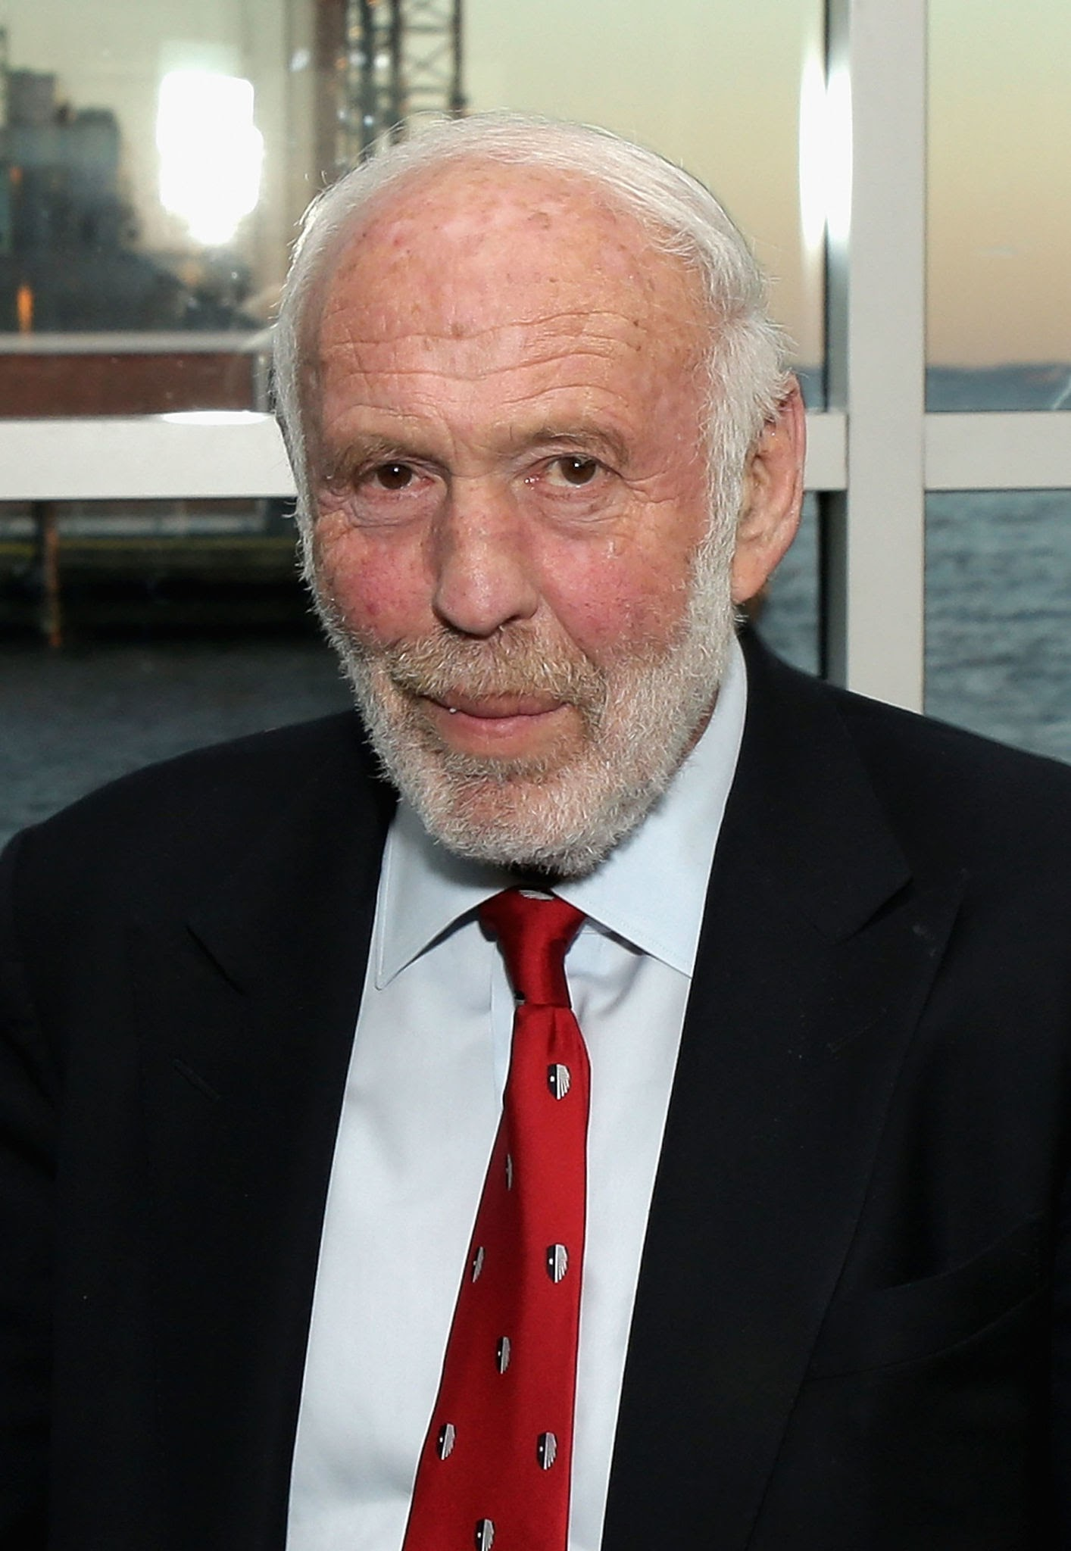
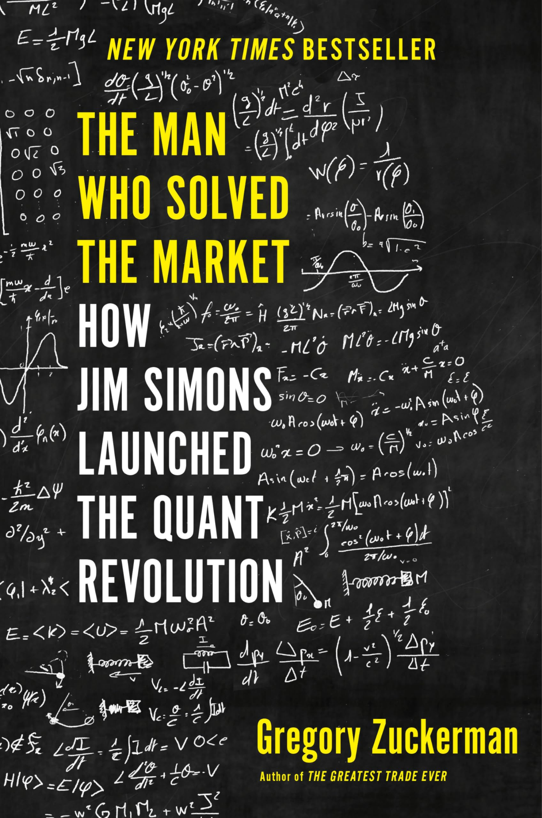


Motivation
Jim Simons
Michael Burry
I love math & finance and I love to read and analyse in silence.
Courtesy: @googleimages

Slide 4

Economic indicators
Economic indicators portray the health of an economy
Indicators: GDP, unemployment rate, inflation etc.
Financial market: one of the most dynamic things
Very difficult to predict the randomness
How do economic indicators affect the financial market?

Slide 5
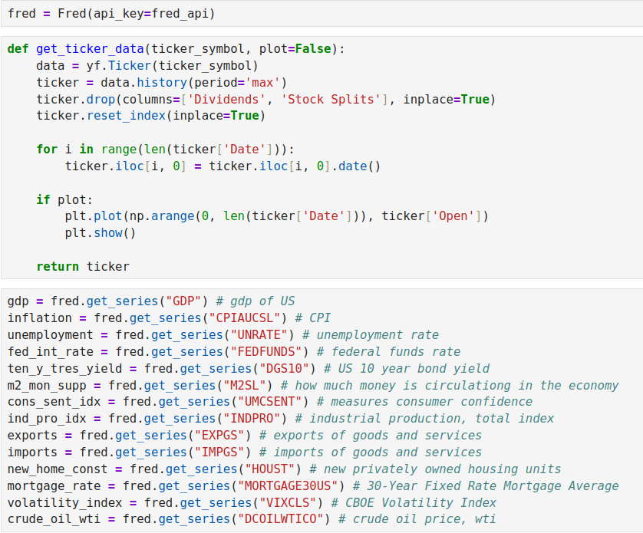
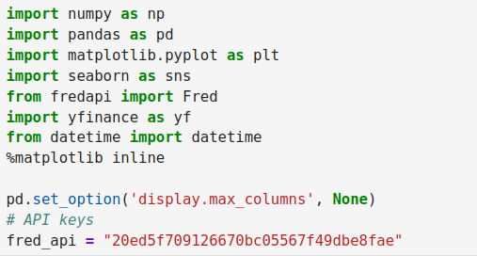
Data collection and challenges
Economics data: FRED (Federal Reserve Economic Data)
Stock market data: Yahoo finance
Python implementation:

Slide 6
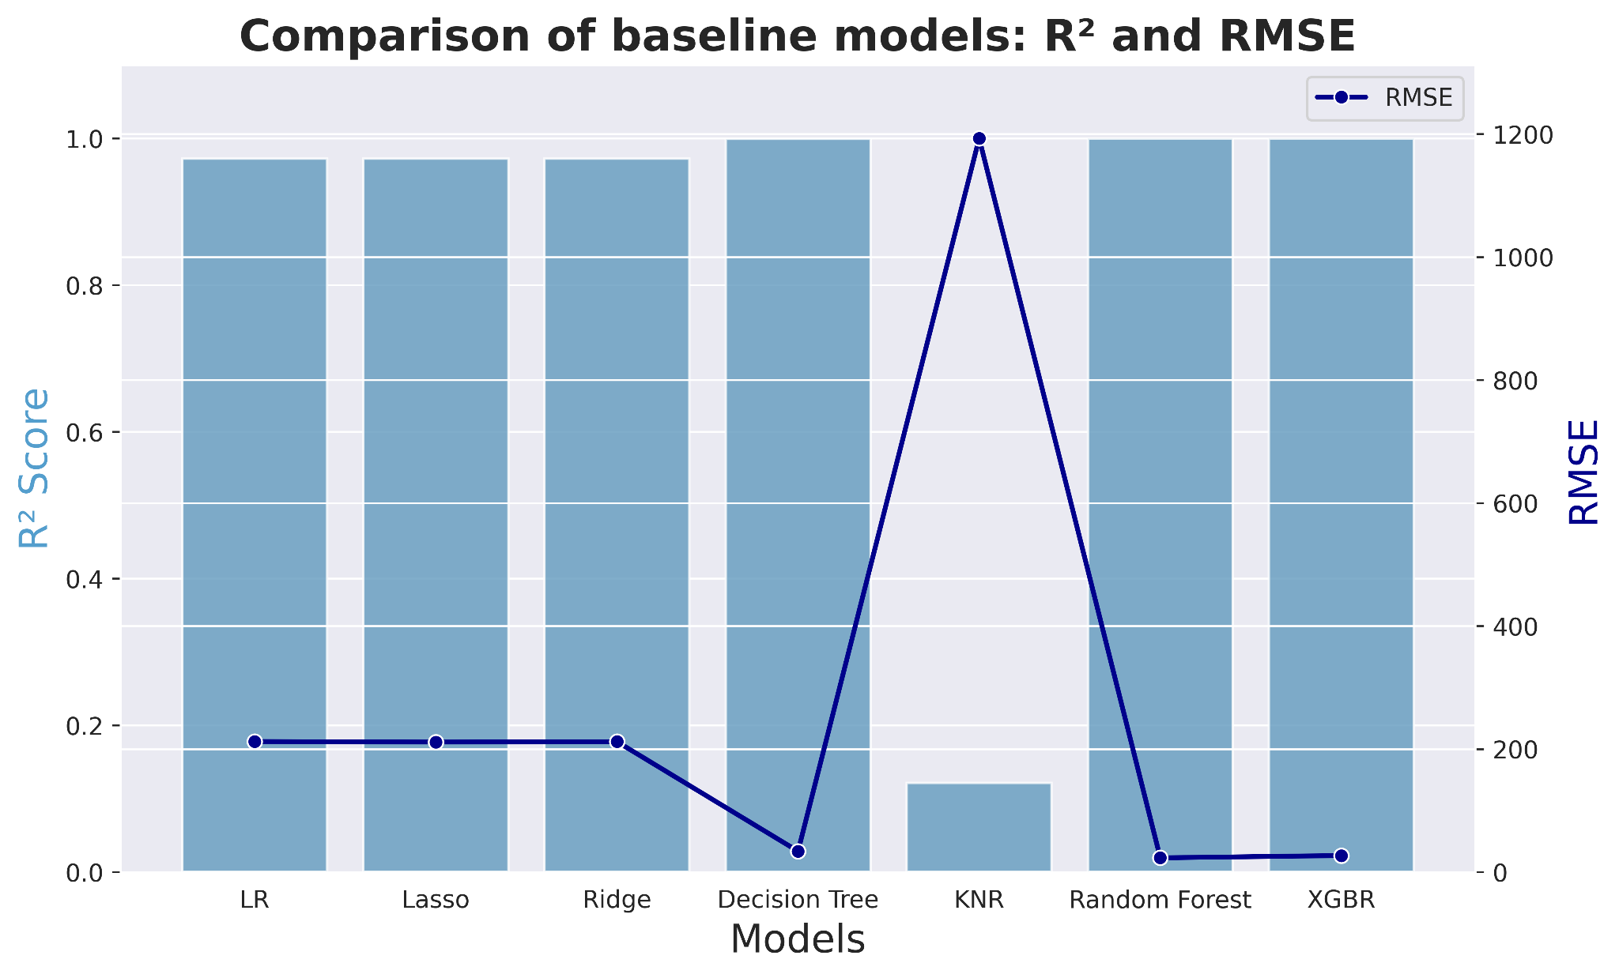
Baseline ML models

Slide 7
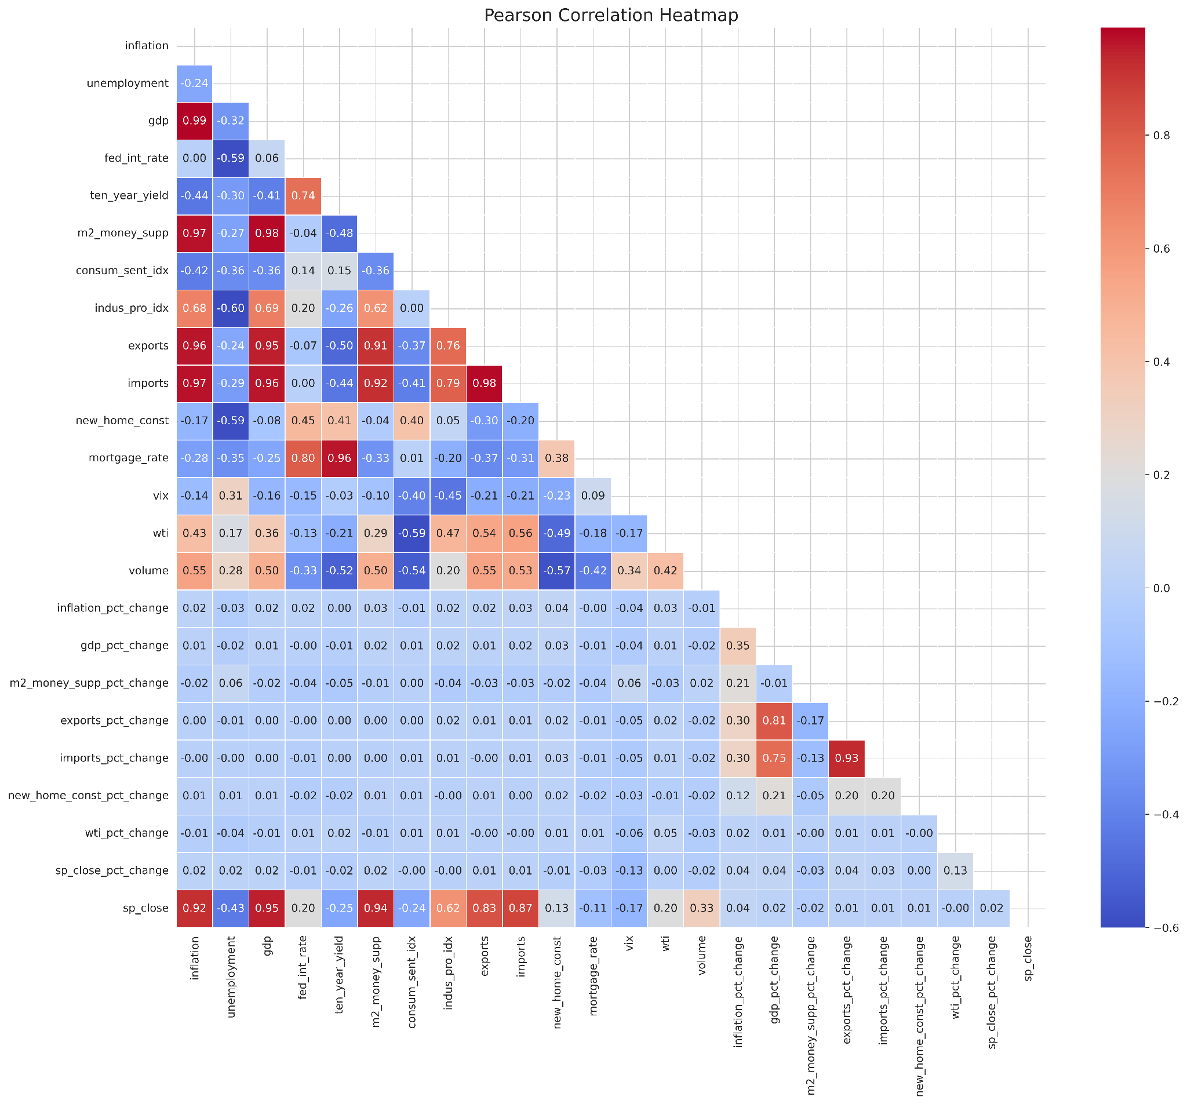
Exploratory data analysis
Multicollinearity
GDP
Inflation
Exports
Mortgage rate
Imports
Imports pct change

Slide 8
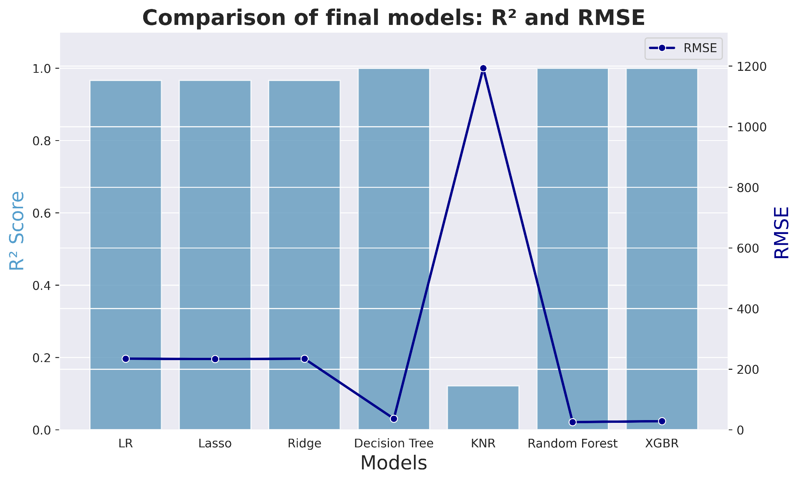
Final ML models

Slide 9
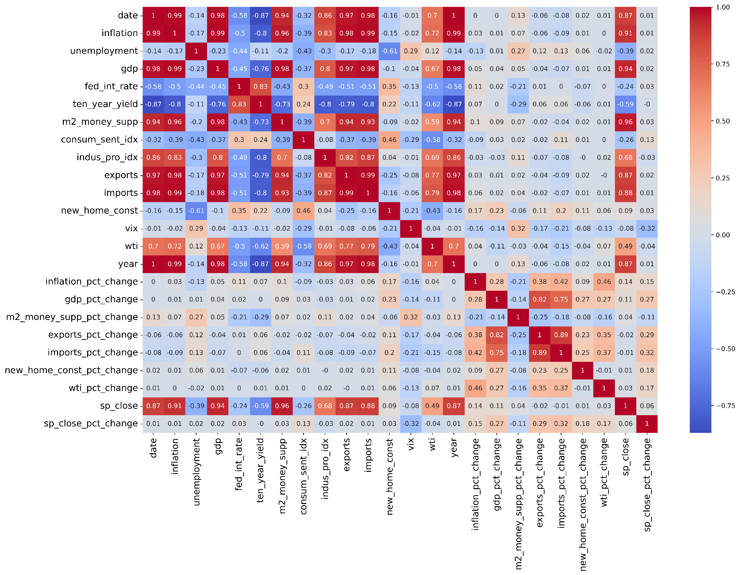
Bivariate analysis
S&P500 correlates (> 0.5) with
Date
Inflation
GDP
M2 money supply
Industry Production
Exports
Imports
How do they correlate?

Slide 10

Summary
Linear models work well
KNR works the worst
Forecasting in future
Streamlit showtime

Slide 11

Summary
Linear models work well
KNR works the worst
Forecasting in future
Streamlit showtime
Thank you!

